Slide 1
Employee Data Analysis using Excel
STUDENT NAME: PREETHI S
REGISTER NO: 312216798
DEPARTMENT: B.com (Accounting & Finance)
COLLEGE: Shri Krishnaswamy College for women

Slide 2
PROJECT TITLE
Employee Performance Analysis using Excel

Slide 3


AGENDA
Problem Statement
Project Overview
End Users
Our Solution and Proposition
Dataset Description
Modelling Approach
Results and Discussion
Conclusion
3/21/2024 Annual Review

Slide 4

PROBLEM STATEMENT
Organizations often struggle to gain meaningful insights from employee data, which is critical for making informed decisions about workforce management, productivity improvement, and employee satisfaction.

Slide 5

PROJECT OVERVIEW
Employee performance is a critical aspect of organizational success. It refers to how well employees carry out their job responsibilities and contribute to the organization's goals. Evaluating and managing employee performance helps organizations ensure that their workforce is productive, efficient, and aligned with strategic objectives and this project can be used to identify the performance analysis and with this we can identify the levels where the employees are.

Slide 6

WHO ARE THE END USERS?
Department Heads and Managers:
Sales Managers: Use performance data to manage and support their team, assess individual performance, and address any issues or needs.
Production Managers: Utilize employee data to optimize production workflows, manage staffing levels, and ensure that performance standards are met.
Employee Relations Specialists:
Employee Relations Managers: Focus on resolving employee issues, improving job satisfaction, and managing employee terminations or transitions.

Slide 7

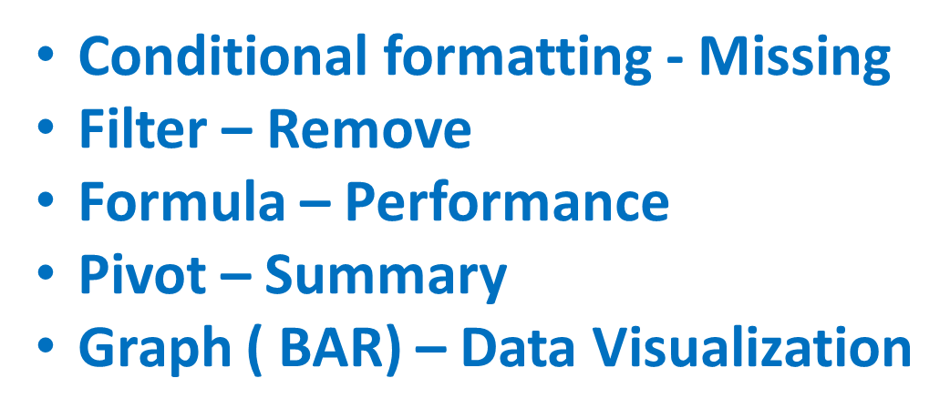
OUR SOLUTION AND ITS VALUE PROPOSITION

Slide 8
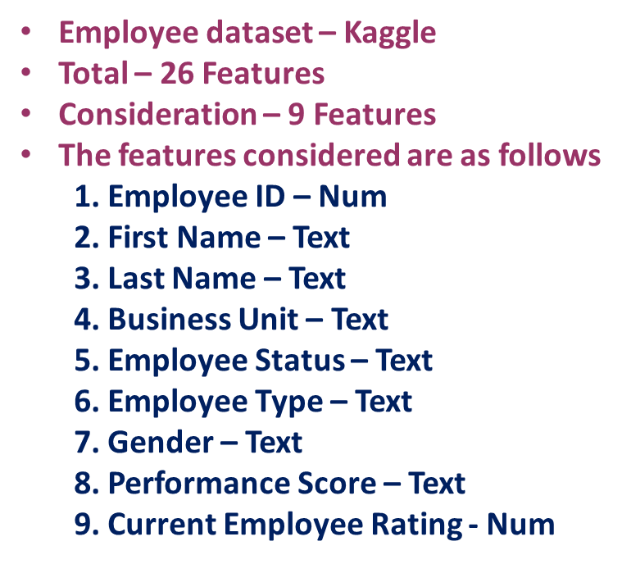
Dataset Description

Slide 9

THE "WOW" IN OUR SOLUTION
Performance Level = IFS(I2>=5,”VERY HIGH”,I2>=4,”HIGH”, I2>=3,”LOW”,TRUE,”LOW”)
3/21/2024 Annual Review
9

Slide 10
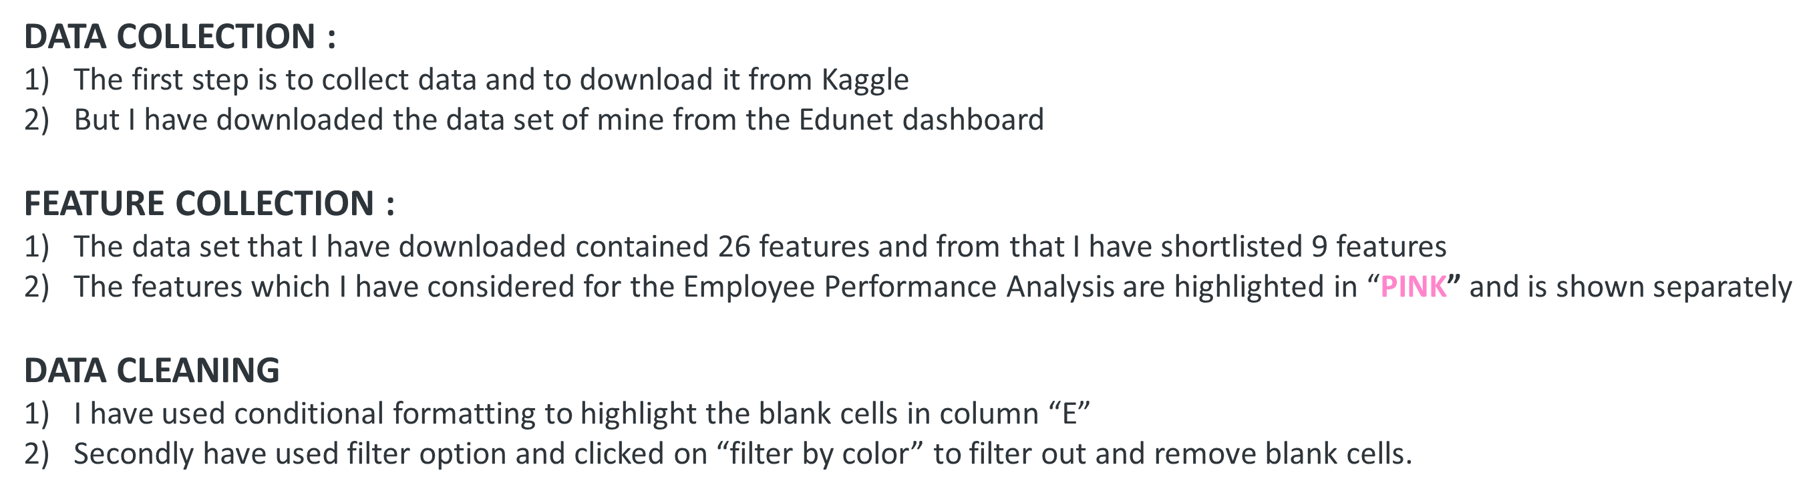
MODELLING
10

Slide 11
MODELLING
PERFORMANCE LEVEL :
I have calculated the performance level with the information of employee ratings
The performance level were classified as “VERY HIGH” if the rating is “5”, “HIGH” If the rating is “4”, “MED” if the rating is “3”, “LOW” if it is “2” or “1”
=LOOKUP(Z8,{1,2,3,4,5},{"LOW","LOW","MED","HIGH","VERY HIGH"}) this is the formula used to calculate the performance level of the employees
SUMMARY :
The pivot table was inserted with Business Units as Rows, Performance level as Columns, Gender Code as Filter and First Name as Value.
The blanks of the columns were removed.
The slicer for employee classification was inserted
VISUALIZATION :
1) The column chart was inserted in order to show the visualization of the pivot table and the pie chart was made for showing the highly performed employees.

Slide 12
RESULTS
12

Slide 13
RESULTS

Slide 14
conclusion
When we analyse the column chart we are able to arrive to a conclusion that the number of employees who are performing at a medium level are more than the ones performing at a very high or high level. So, it is the duty of the organisation to provide more opportunities and encouragement for those employees in order to achieve the organisational goals faster.
When we analyse the pie chart of the highly performed employees it can be concluded that the Business Unit of “PL” Has the highest level of ‘HIGHLY PERFORMED EMPLOYEES’ and so the organistion must provide a proper recogition to that business unit and the employees of it
The very highly performed and highly performed must be given proper incentives, promotion and increment.

